Slide 1
CSC440 Data Mining
Final Project
The Relationship between Health and Health Factors
By Zhuoyou Wang & Yang Wang

Slide 2

Unsafe Sex
Community Safety
Smoking
Quality Of Care
Family & Social Support
Income
Access To Care
Health Outcome
Built Environment
Air Quality
Diet & Exercise
Education
Employment
Alcohol Use

Slide 3

Motivation & Background
-As people’s living standard gets higher in modern society, people start to pay more attention to health issues
-We believe that health is closely related to health factors
-By the data ‘2011 County Health Rankings’, we can learn more about health outcomes and health factors by county level in the United States
-Our goal is to find relationship between health and health factors in generally and individually

Slide 4
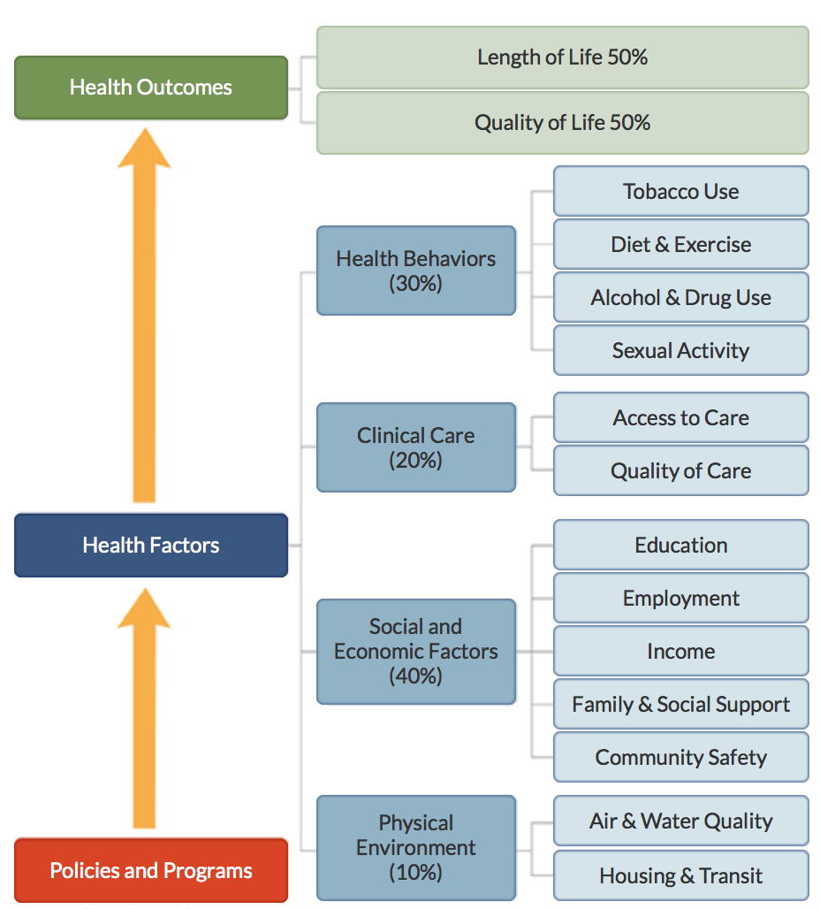
Elements of the data set

Slide 5
Data Preprocessing
In the original data set it contains rankings for each county which we don’t need for the purpose of this project. Moreover, for some of the data the values have been reversed due to their positive framed measure. All the values in the data are standardized using Z-score. Therefore, I don’t have to go through all the trouble to normalize values. I get off observations that has null values, and get rid of columns that show the rankings for corresponding counties.

Slide 6
Health factors and outcomes correlations
Intuitive
Not Intuitive

Slide 7
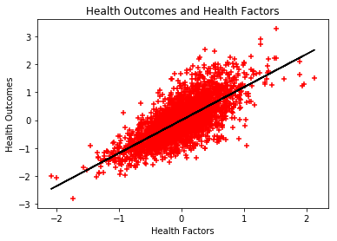
Overall
Overall health outcomes and health factors:
There is a strong correlation between overall health outcomes and overall health factors. Their correlation coefficient is 0.7315

Slide 8
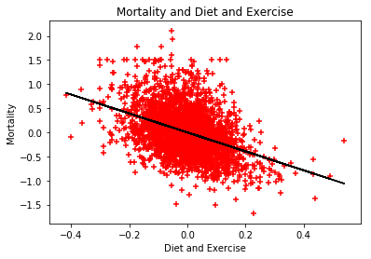
Intuitive Correlation
Mortality and Diet and exercise(-0.409031):
Eating health and exercise regularly “can reduce the chance of getting heart disease, diabetes, depression and several types of cancer particularly breast and colon cancers” according to The Secret to Better Health - Exercise. Therefore, good diet and regular exercise lead to less disease, which eventually imply lower mortality rate.

Slide 9
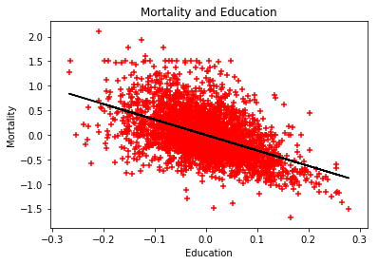
Intuitive Correlation
Mortality and Education(-0.509406):
Better education usually indicates the person has more knowledge, and they are more likely to have healthy behaviors. Moreover, higher level of education usually means a better job and having a better resources for good health. Therefore, they tend to live longer in the long run.

Slide 10
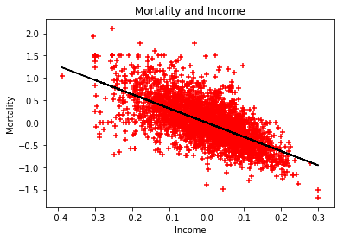
Intuitive Correlation
Mortality and Income(-0.655259):
Higher income leads to better living standard and better medical attention in general, hence a better chance to live longer.

Slide 11
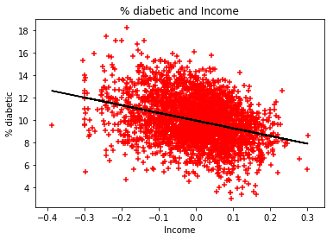
Intuitive Correlation
Diabetic and Income(-0.323939):
Low income is usually related with stress caused by uncertainty of food, housing and medical care etc. According to Andrew Curry “stress amps up craving for energy dense foods; in people, and also increase the level of cortisol level, which has a direct link between cortisol and diabetes.” Therefore, low income is more likely to cause diabetes.

Slide 12
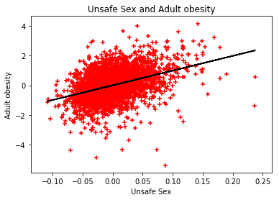
Not Intuitive Correlation
Unsafe sex and Adult obesity (0.394659):
The reason behind this could be that being obese affects people’s sex drive, desire and performance; therefore, obese people is look for extra stimulations for their sex life. According to Colette Bounchez, “Over weight will affect the hormones lead to active libido”. Moreover, because of obese people’s body shape it is harder for them to have access to sex, so that obesity people are willing to do some extra to have that access to sex. Thus, there is a higher percentage of obesity people have unsafe sex than normal weight group.

Slide 13
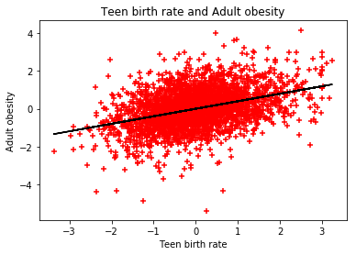
Not Intuitive Correlation
Teen birth rate and Adult obesity(0.389539):
When a teenage girl is pregnant she needs a lot of nutrition to keep her body and baby growing. According to Debolina Raja, this can cause eating disorder such as bulimia. Debolina also mentions that teen moms are more likely to be depressed during pregnancy. Depression could trigger stress eating. Taking these two factors into account, we might be able to explain why Teen birth rate has a positive correlation with adult obesity.

Slide 14

Classification
200%
GROWTH

Slide 15

Decision Tree
-For the classification analysis, we choose decision tree in order to classify and predict health outcomes
-Attribute selection measure: information gain (entropy) and Gini index
-Attributes: 13 health factors(i.e. smoking, education, income, and etc.)
-Class: health outcomes (‘<0’ and ‘>=0’)
-Number of training set = 2000
Number of testing set = 1017

Slide 16
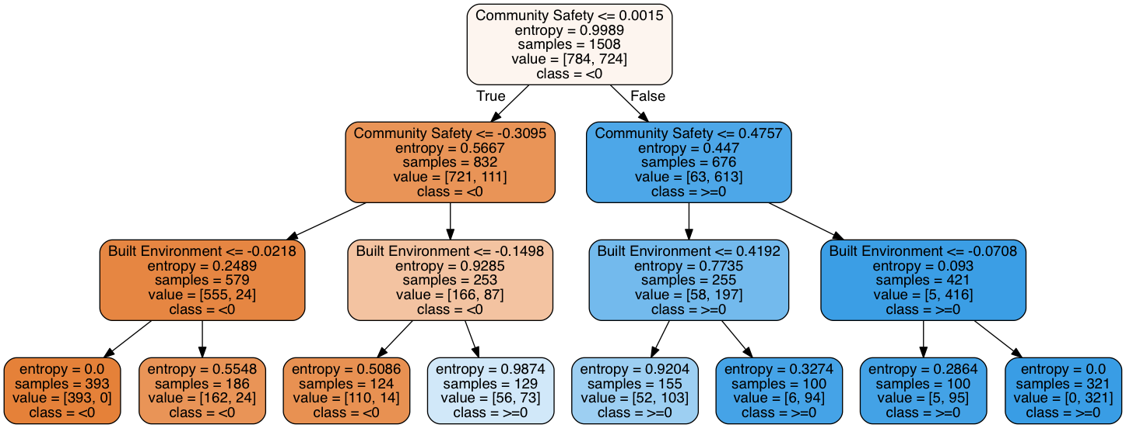
Decision tree with entropy

Slide 17
Decision tree with entropy
The accuracy of the decision tree with entropy is 0.89282202556538837
For a randomly generated input/attributes: [-0.05,0.78,0.22,0.34,-0.55,-0.82,-0.03,0.64,0.78,0.62,-0.79,-0.66,0.03], we use the tree model to predict a health outcome and get: ['<0']

Slide 18
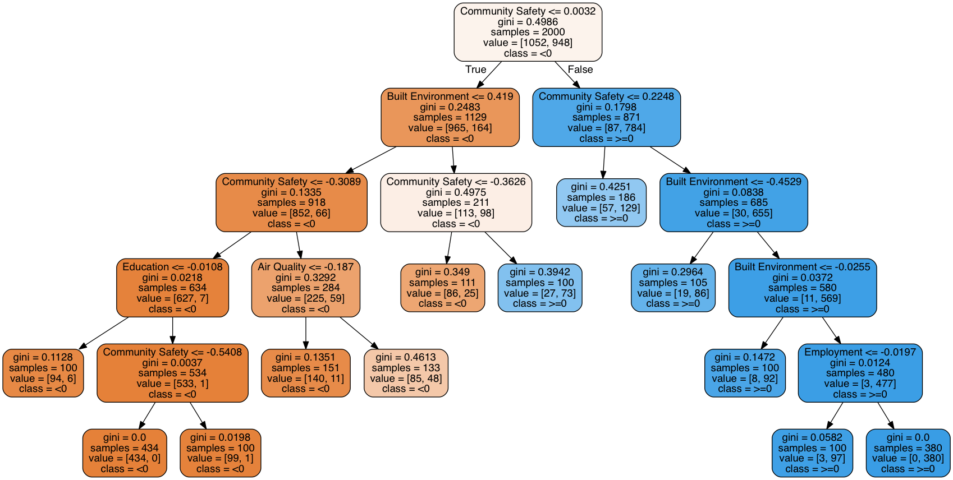
Decision tree with Gini Index

Slide 19
Decision tree with Gini Index
The accuracy of the decision tree with entropy is 0.89282202556538837
For a randomly generated input/attributes: [-0.05,0.78,0.22,0.34,-0.55,-0.82,-0.03,0.64,0.78,0.62,-0.79,-0.66,0.03], we use the tree model to predict a health outcome and get: ['<0']
The accuracy and predictions of the 2 decision trees are identical
Due to many unique values and a binary class, either information gain or Gini index is good in this case

Slide 20
ROC for Decision Tree

Slide 21
ROC for Decision Tree
According to the ROC, we can get the accuracy of the decision tree by measuring the area under the curve, which is 0.8813
The accuracies measured by mean score (0.89) and by ROC (0.88) are close to each other
Therefore, the decision tree that we build is reliable

Slide 22
Most Important Attribute
From the 2 decision trees, we can tell community safety and built environment are top 2 attributes that the decision trees split upon
Thus, the top one attribute (community safety) can be considered as significant contribution to people’s health outcomes (whether people are healthy or not)
In reality, it also makes sense since people in a safe community are likely to enjoy better living standards and less likely to suffer form contagious diseases, such as sexually transmitted infections
Better living standards usually correlate with better health

Slide 23
Application
-Use the same methodology to find specific correlations between diseases and factors based on state/county level
-By focusing on specific correlations and morbidity of specific diseases in different states, local government are able to carry out policies or programs more effectively
-For example, if there is a strong correlation between unsafe sex and adult obesity in California, then the local government may implement the following policies or programs:
-decrease the prices or taxes on condoms
-distribute free condoms and booklets propagandizing harms of unsafe sex

Slide 24
Conclusion
-Overall health outcomes and health factors are highly correlated with correlation = 0.7315
-There exist individual correlations between diseases and factors (i.e. obesity vs. unsafe sex with correlation = 0.3947)
-We are able to use a decision tree to classify and predict health outcomes given correct attributes/input with the accuracy of 88.13% by ROC curve and 89.28% by mean
SAVE
ELECTRICITY

Slide 25
References
Virginia Commonwealth University Why Education Matters to Health: Exploring the Causes February 13th, 2015 https://societyhealth.vcu.edu/work/the-projects/why-education-matters-to-health-exploring-the-causes.html
Andrew Curry The Sheer Stress of an Environment Contributes to Obesity and Diabetes December 17th, 2015 http://nautil.us/issue/31/stress/why-living-in-a-poor-neighborhood-can-make-you-fat
Colette Bouchez Better Sex: What’s Weight Got to Do With it?
https://www.webmd.com/sex-relationships/features/sex-and-weight#1
Debolina Raja 9 Health Rishs And Realities of Teenage Pregnancy February 13th, 2017
http://www.momjunction.com/articles/health-risks-of-teenage-pregnancy_00377831/#gref
Data set source:
https://github.com/dataiap/dataiap/tree/master/datasets/county_health_rankings
http://www.countyhealthrankings.org/explore-health-rankings/use-data/exploring-data
Professor Luo’s help and guidance

